Slide 1
Welcome Everybody

Slide 2
Optical Character Recognition(OCR)
Team members:
Tasnim Hossain Timom(193006)
Zenia Akter Ritu(193032)
Promi Biswas(193060)

Slide 3
Summary:-
1.Introduction
2.Motive & Goals
3.Stages of Optical Character Recognition
4.Architechture of OCR
5.Design of Screen shots for OCR
6.Application of OCR
7.Conclusion & Future Scopes
8.References

Slide 4
1.Introduction
OCR is a technology that analyzes the text of a page and turns the letters into code that may be used to process information. OCR is a technique for detecting printed or handwritten text characters inside digital images of paper files, such as scanning paper records (optical character recognition). OCR systems are hardware and software systems that turn physical documents into machine-readable text.

Slide 5
Motive & goals
OCR is used when recreating a similar document in paper as a document in electronic form takes more time.
The converted text files take less space than the original image file and can be indexed.Hence the use of OCR adds an advantages to the user who had to deal with conversion of great amount of paper works in to electronic form.

Slide 6
Stages of Optical Character Recognition:
Pre-processing
Segmentation
Recognition
Post-processing

Slide 7
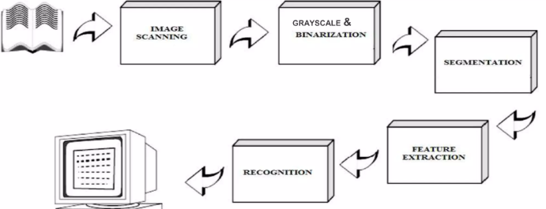
Architecture of OCR

Slide 8
Features
OCR is different as it has 90% accuracy in recognizing the text and above all the app is so handy that there is no requirement of following any additional instructions.You can easily do the following task:
1.Edit the extracted text
2.Convert an image into the text
3.Copy text to the clipboard.

Slide 9
Applications of OCR
Data entry for business documents,check,passport,bank statement and receipt.
Extracting business card information into a contact list.
Make electronic images to printed document.

Slide 10
Conclusion & Future Scopes
Automatic data entry is most attractive and lucrative technology.
Saving time & space with electronic data entry procedure.
OCR can be used for Research & Development Purposes.
Handwritten documents recognized in future.

Slide 11
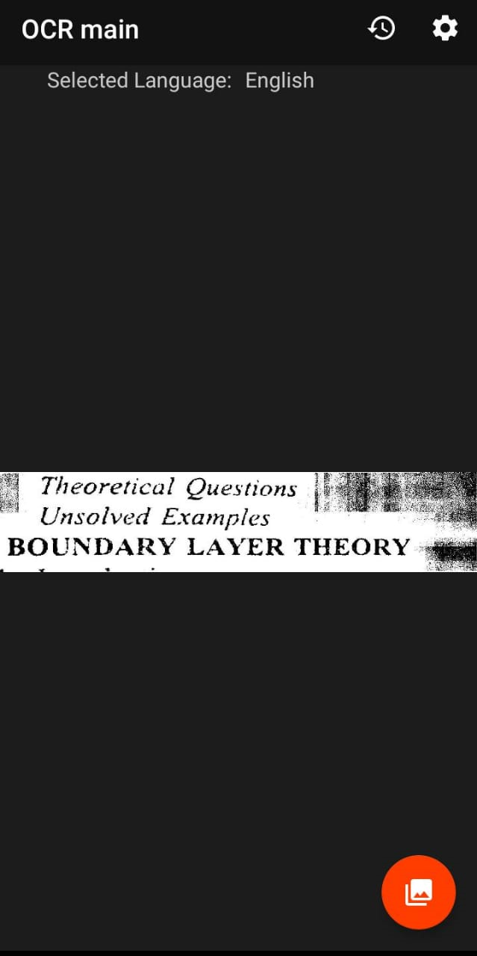
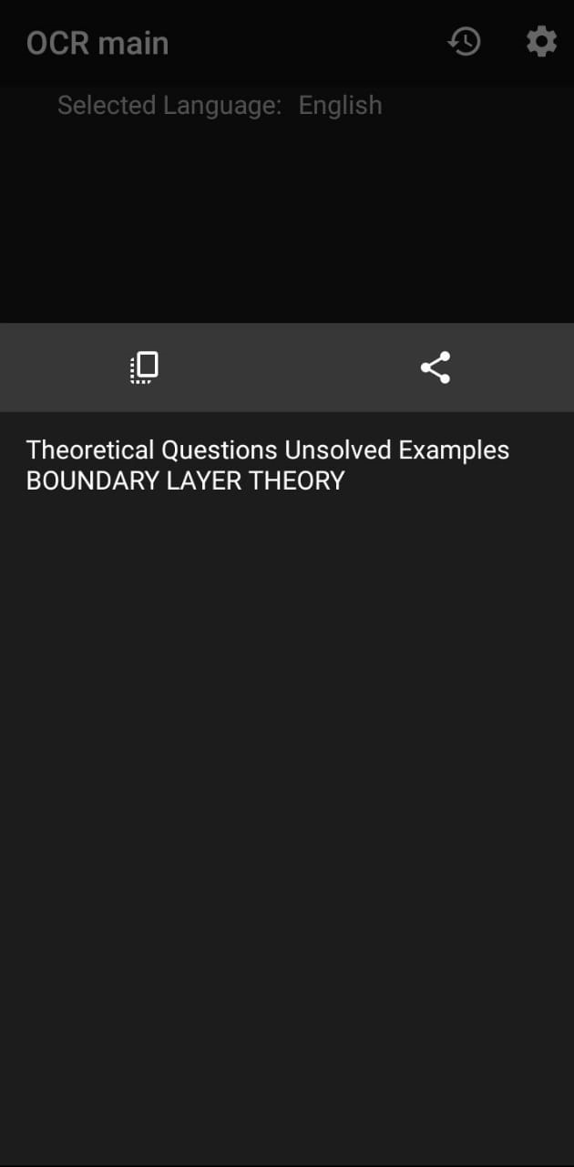
Design of screenshot for OCR

Slide 12
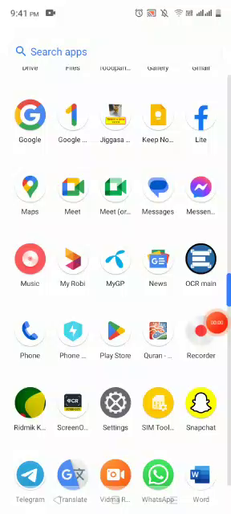
Video on the application

Slide 13
References
https://github.com/tesseract-ocr/tesseract
https://www.youtube.com
https://developer.android.com/samples?language=java

Slide 14


